Slide 1
Main Phases of Mobile IP
Agent Discovery
Registration
Tunneling

Slide 2
Agent Discovery
One initial problem of an MN after moving is how to find a agent.
How does the MN discover that its has moved?
For this purpose mobile IP descries two methods:
Agent Advertisement
Agent Solicitation

Slide 3
Agent Advertisement
Agent Advertisement HA and FA periodically send advertisement messages into their physical subnets. MN listens to these messages and detects, if it is in the home or a foreign network (standard case for home network). MN reads a COA from the FA advertisement messages.

Slide 4
Agent Solicitation
Agent Solicitation if no agent advertisement are present or the inter- arrival time is too high and the MN has not received a COA by other reason.
So, the mobile node must send the Agent Solicitations.
These solicitation messages do not flood the network but basically an MN can search for an FA endlessly sending out solicitation messages.

Slide 5
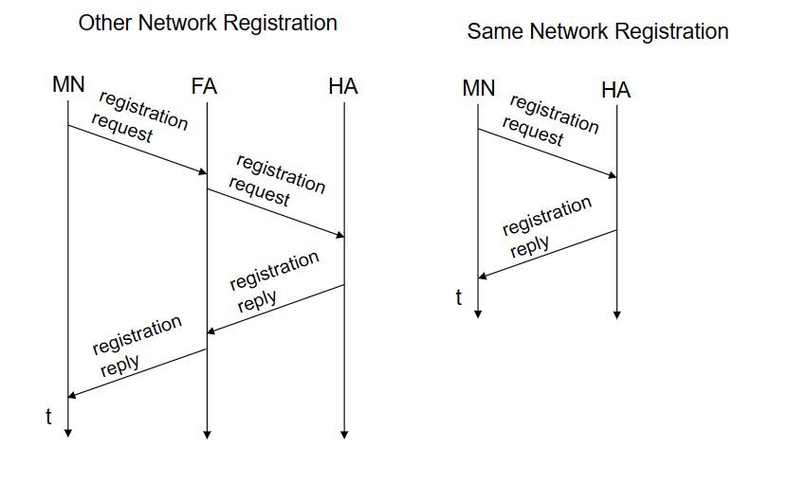
Registration

Slide 6
Registration
Once a mobile IP node has received a COA, that address must be registered with the home agent. This involves following four steps.
Step 1:
Following the receipt of a foreign agent advertisement, a mobile node sends a mobile IP registration message to the foreign agent.
The registration message is carried within a UDP datagram and sent to port 434.
The registration message carries a COA advertised by the foreign agent, the address of the home agent (HA), the permanent address of the mobile node (MA), the requested lifetime of the registration, and a 64-bit registration identification.
The requested registration lifetime is the number of seconds that the registration is to be valid. If the registration is not renewed at the home agent within the specified lifetime, the registration will become invalid

Slide 7
Registration
Step 2:
The foreign agent receives the registration message and records the mobile node’s permanent IP address.
The foreign agent then sends a mobile IP registration message to home agent.
Step 3:
The home agent receives the registration request and checks for authenticity and correctness.
The home agent binds the mobile node’s permanent IP address with the COA; in the future, datagrams arriving at the home agent and addressed to the mobile node will now be encapsulated and tunneled to the COA.
The home agent sends a mobile IP registration reply containing the HA, MA, actual registration lifetime, and the registration identification of the request that is being satisfied with this reply.

Slide 8
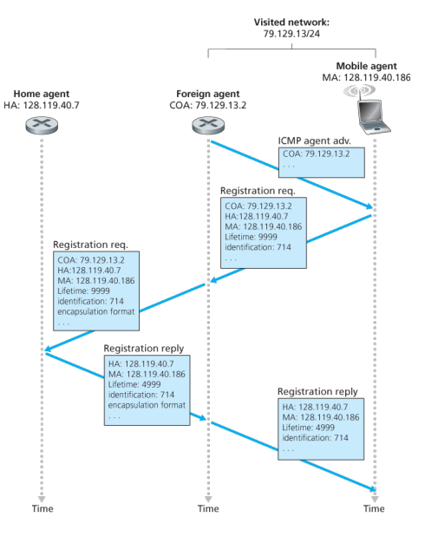
Registration
Step 4:
The foreign agent receives the registration reply and
then forwards it to the mobile node

Slide 9
Thank You

